Slide 1
Tooth morphology I, eruption timings
DENT1060: Dental Practice IA

Slide 2
Learning objectives
To describe the characteristics of the dentition and the dental anatomy
To discern differences between the deciduous and adult dentition

Slide 3
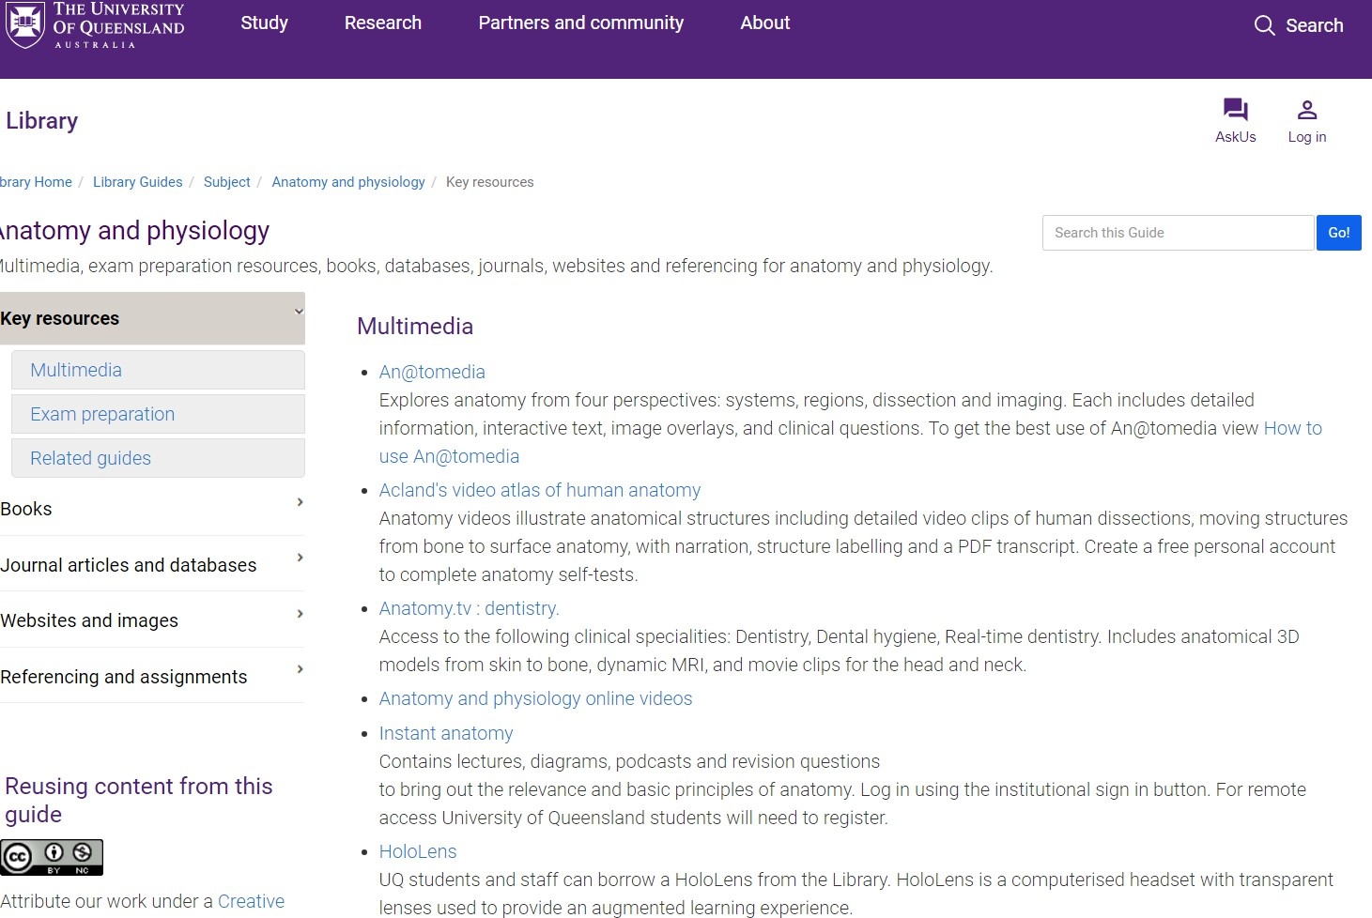
UQ anatomy resources
https://guides.library.uq.edu.au/anatomy-and-physiology
Anatomy.tv: dentistry

Slide 4
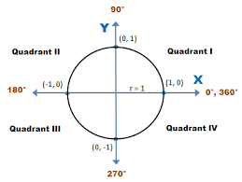
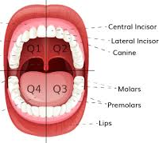
The dentition
Dental arch
The dental arches describe the upper and lower jaws
Upper arch/jaw -> the maxilla and maxillary dentition
Lower arch/jaw -> the mandible and mandibular dentition
Dental quadrants
Remember, the quadrants is a descriptive terminology to identify the location of specific dentition
Quadrant 1 (upper left on the patient, patient’s upper right)
Quadrant 2 (upper right on the patient, patient’s upper left)
Quadrant 3 (lower right on the patient, patient’s lower left)
Quadrant 4 (lower left on the patient, patient’s lower right)

Slide 5
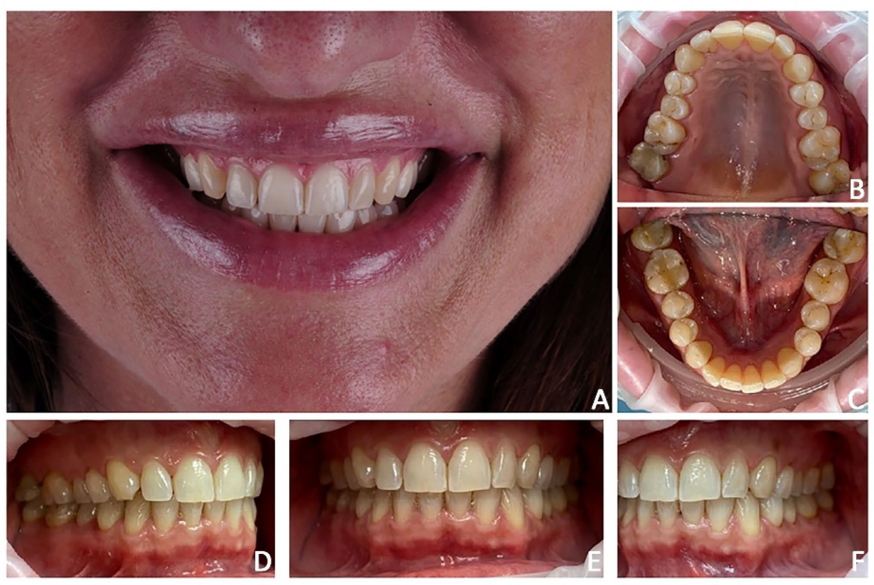

Slide 6
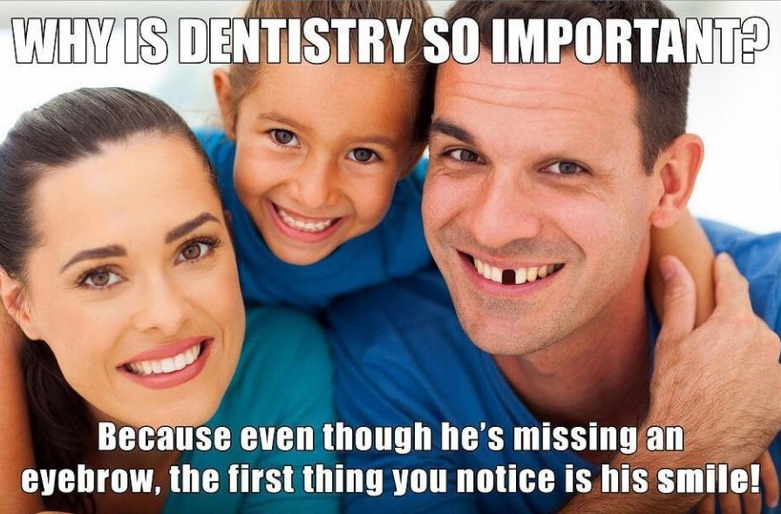
Functions of the dentition
The main functions of the dentition are
Protect the oral cavity*
Mastication of foods
Assist the chemical digestive pathway by breaking down food physically
Speech and phonetics
Subjective, the dentition also contribute to the aesthetic appearance

Slide 7
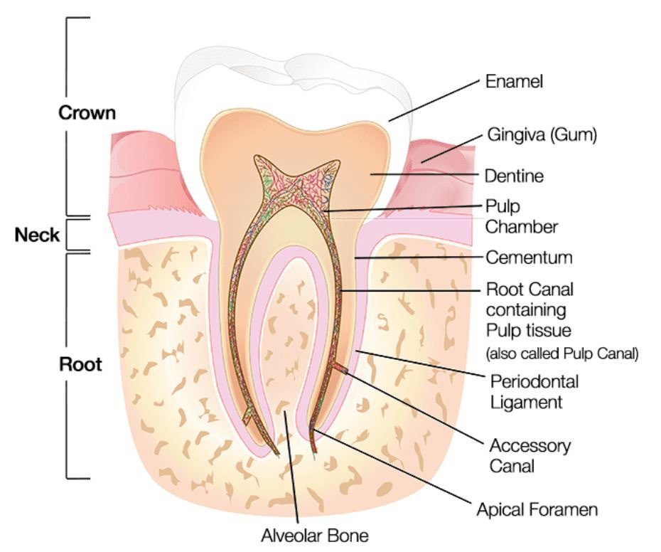
Anatomy of the dentition
The tooth, as a functional unit, is described by the tooth itself and its supporting periodontium
The tooth can be described by:
The crown describes the head of the tooth
Layers: enamel, dentine, pulp (pulp chamber)
The root describes the anchorage of the tooth
Layers: cementum, dentine, pulp (root canal)
The crown and root are demarcated by the cervical line at the
cementoenamel junction
The periodontium can be described by:
Soft tissue
Gingiva, periodontal ligament
Hard tissue
Cementum, alveolar bone

Slide 8
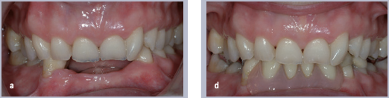
Layers of the tooth
Enamel: mineralised, protective outer layer of tooth
Highly mineralised to provide structural integrity
Demonstrates translucency due to its high level of mineralisation
Dentine: heterogenous inner layer of tooth
Relatively mineralised but also contains higher level of organic tissue and fluids
Forms the bulk volume of tooth -> it is what makes tooth yellow
Pulp: the neurovascular supply in the core centre of tooth
No mineral content as it is formed by blood vessels, nerves, immune cells, etc
Known as halo effect of enamel

Slide 9
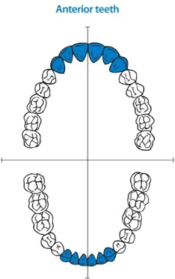
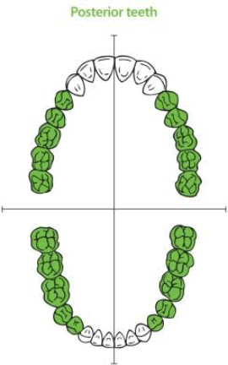
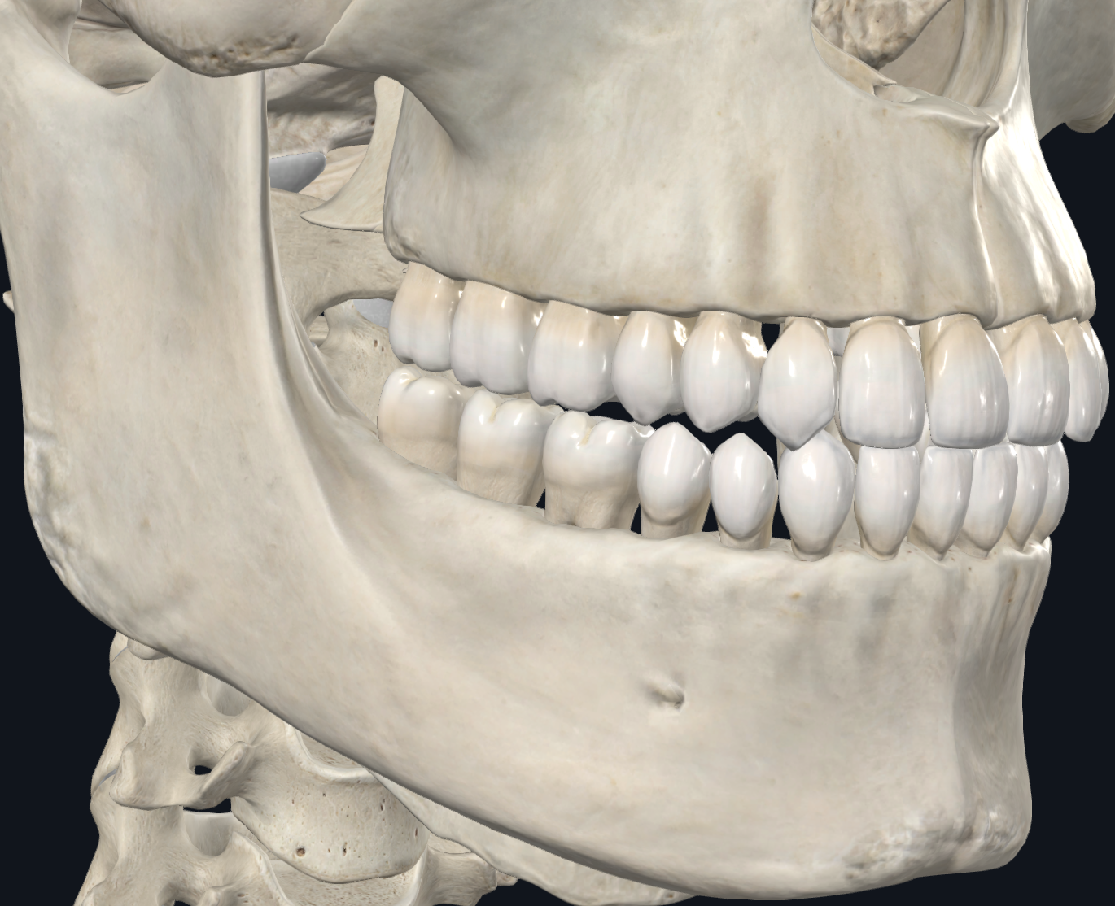
Types of teeth
Anterior teeth (front)
Incisors
Central
Lateral
Canines
Posterior teeth (back)
Premolars
First
Second
Molars
First
Second
Third

Slide 10
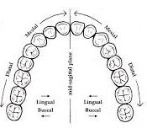
Directional terminology of the dentition
Remember, this is a revisitation!
The directional terms that are used to describes surfaces of dentition are:
Buccal/Labial (front surface)
Labial -> towards lips (reserved for anterior dentition only)
Buccal -> towards cheeks (reserved for posterior dentition only)
Lingual/palatal (internal surface)
Palatal -> internal surface of maxillary dentition
Lingual -> internal surface of mandibular dentition
Mesial (proximal direction)
Distal (distal direction)
Incisal/occlusal (superior surface)
Incisal -> anterior dentition
Occlusal -> posterior dentition

Slide 11
Functions of teeth by type
Incisors:
To cut
Palatal/lingual surfaces guide food into the mouth
Canines:
To grasp
Guides the jaw in lateral movements
Longest tooth by type -> most anchored -> able to withstand the stress/load of the entire jaw during grinding
Premolars:
Aids the canine in grasping and grinding
Transitional anatomy design between canine and molar
Molars:
To crush
Withstands the most prominent force during occlusion
Largest tooth by type -> greatest volume of tooth -> able to withstand stress/load of jaw during occlusion

Slide 12
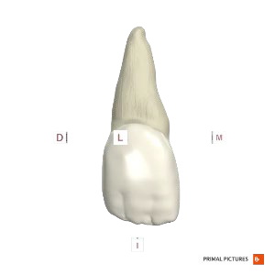
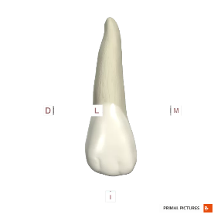
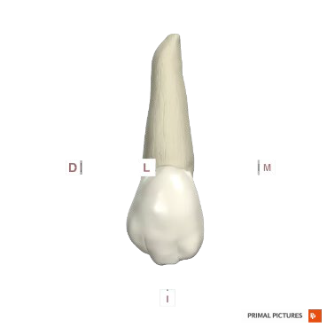
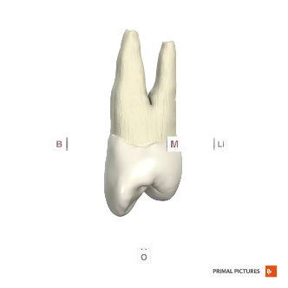
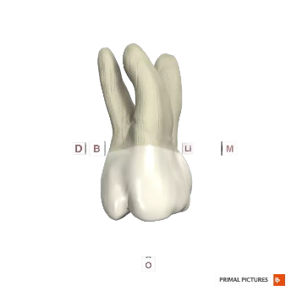
Notice that as we transition from incisor to molar:
The root length elongates
The crown becomes “multi-headed”
Referred to as cusps when they are no longer thin and narrow like incisal edges
The crown design increases in complexity

Slide 13
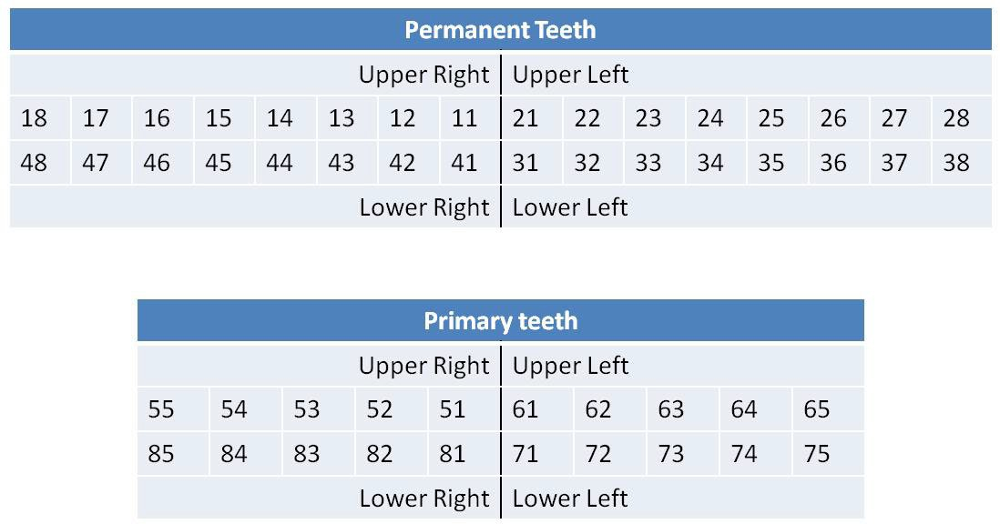
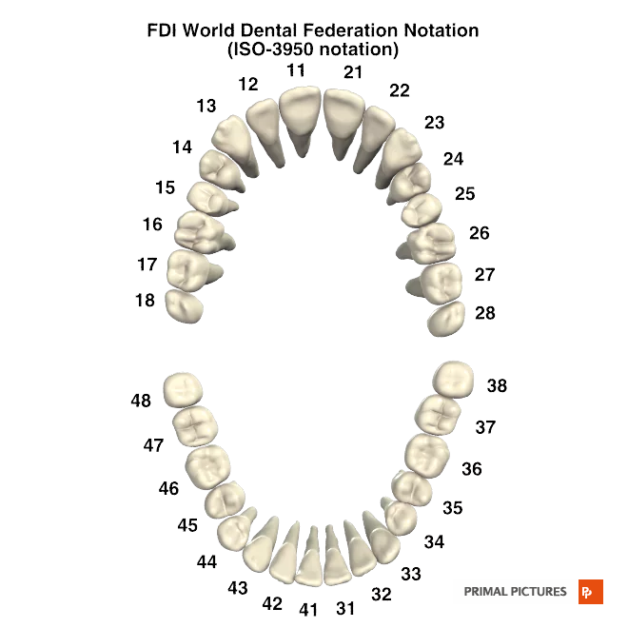
Tooth numbering system
Charting universally follows the Fédération Dentaire Internationale’s notation (FDI): two-digit charting system
The first digit represents the quadrant
The second digit represents the tooth number
Teeth are numbered by tooth type from incisor -> molar
Only America follows their own numbering system where numbering is simply brute forced
Regardless of quadrant or tooth type -> numbered sequentially 1, 2, 3, 4…
N.B. tooth surface naming system will be visited in “dental charting” lecture

Slide 14
Characteristics of teeth

Slide 15
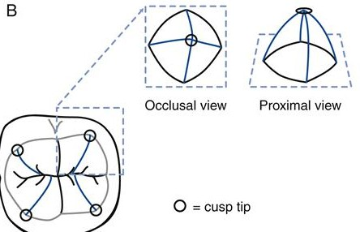
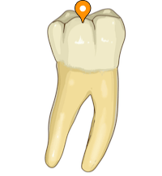
Cusps
A cusp is a pyramidally-shaped elevation, or peak, defining complex eminences on the superior surface of the crown
The highest point of the cusp is referred to as the cusp tip
Cusps are named by its location relative to the approximal surface it is connecting with
When there are 2 cusps, we define by the main surface it is involved with, eg Buccal & Lingual cusps
When there are 3 or more cusps, we define by the main surface, but if it is positioned in the corner of the tooth, the 2 surfaces it shares, eg Mesio-lingual cusp
Because cusps are named to dentition with pyramidal elevation, it applies to all posterior dentition, but also the canine (despite being anterior dentition!)

Slide 16
The canine has an incisal surface, but a cusp tip
By all intents, remember that the canine is described anatomically by anterior dentition traits
It’s only uniqueness is that its incisal edge is non-existent and instead a cusp tip
We will see that the canine cannot be described by cuspal anatomy, only incisal anatomy

Slide 17
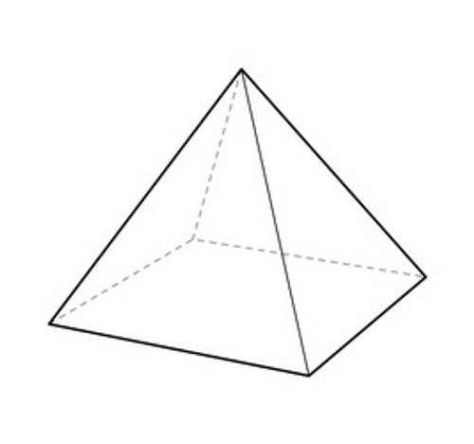
Ridge
Despite common logic, the formation of the tooth does not begin from the apex of the root (the lowest base of the tooth), but the cusp tip/incisal edge of the tooth!
IE, if the cusp is a pyramidal shape, naturally we can also define the local surfaces that descend from the cusp tip
The ridge is named by the following convention:
The direction the surface is facing
The cusp it is associated with
EG, buccal ridge of lingual cusp
This should given you the idea that it is the lingual cusp of some tooth, and it is the surface that faces the buccal direction, IE faces towards the centre of the tooth
Cusp tip
Ridge surface

Slide 18
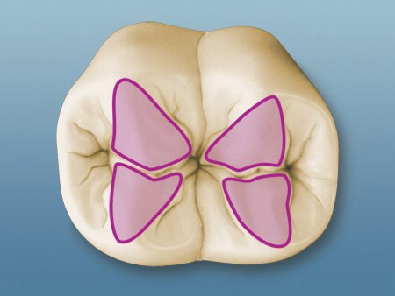
Triangular ridge
Denoted as such due to the narrow apex (cusp tip) and wide base (along occlusal surface)
As long as the tooth has multiple cusps, ridges will communicate with each other in some fashion
Triangular ridges communicate with each other at the base to form prominent depression/sulcus
Function:
Structural integrity to the cusp -> adds volume to the cusp
Topography -> formation of depression and sulcus allows complex distribution and interaction of food with the cusp tips -> efficient crushing

Slide 19
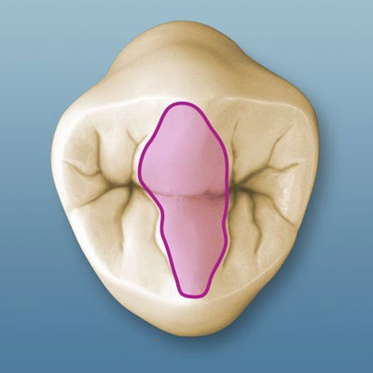
Transverse ridge
Prominent elevation of the triangular ridge to near eliminates the depression/sulcus formed between two or more ridges
IE, forms an elevated connection between two cusps, forming a relative union
Function:
Structural integrity to tooth -> adds volume to the communicating pathway between the two cusps

Slide 20
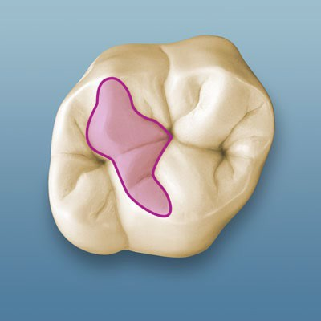
Oblique ridge
Unique ridge formation, and a variant of transverse ridge, that forms only in maxillary molars
The maxillary molar has 4 uneven cusps with minimal symmetry
The oblique ridge always communicates between the disto-buccal cusp and mesio-palatal cusp
Concurrently, it forms a prominent oblique groove adjacent to the MP cusp, communicating with the disto-palatal cusp

Slide 21
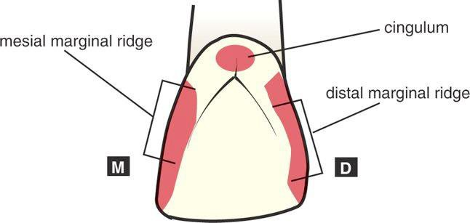
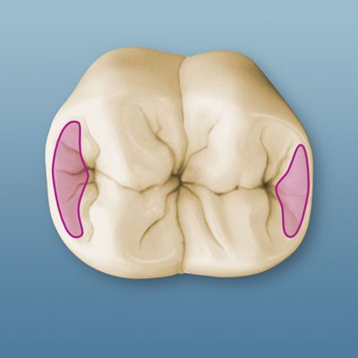
Marginal ridge
Locally elevated ridge that forms the terminal boundary of the lateral edges of the dentition
On anterior dentition, this forms the mesial/distal marginal ridges along the palatal/lingual surfaces
On the posterior dentition, this forms the mesial/distal marginal ridges along the occlusal surface
Function:
Structural integrity against flexion -> holds the structures along the terminal ends of the ridge together
The destruction of a marginal ridge pre-disposes the tooth to cuspal fracture (on the involved area), however sometimes we have no choice but to remove this entity to remove disease associated with the area

Slide 22
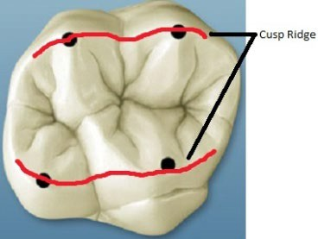
Cusp ridge
A specific outline of the circumference of the tooth, following the highest elevation peripherally
IE, the highest elevation of the cusps and ridges form what is known as the cusp ridge
Despite common logic, cusp ridge to cusp ridge is not a primary form of contact between opposing dentition

Slide 23
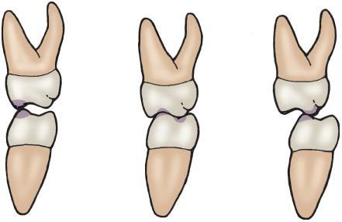
Occlusal contact
Occlusal contact refers to the intricate relationship of contact between opposing dentition, primarily driven by its anatomy
The alignment of occlusion, in the ideal occlusion (proper tooth positioning), is when the cusp tip/ridge of one tooth meets the central groove of the opposing tooth
It is only when there is lateral movement of the jaw, the opposing dentition may simultaneously meet at both cusp tips/ridges

Slide 24
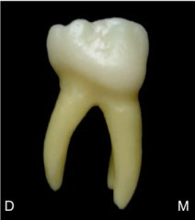
Cervical ridge
A subtle ridge that runs mesio-distally along the cervical region of all dentition, however is most prominent on the permanent molars and primary dentition
Remember, the cervical region is the location that approximates the junction between the crown and the root
Note that the cervical ridge does not extend into the root, only the crown, where the enamel exists

Slide 25
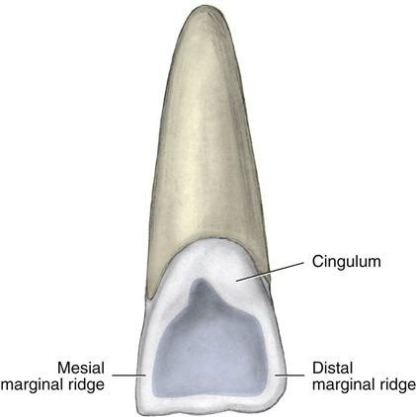
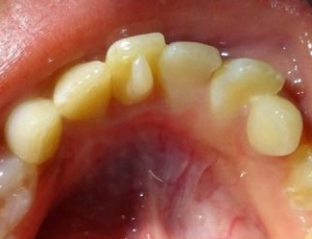
Back to anteriors, elevation
Cingulum:
Local prominence formed on the cervical region of the crown, along the lingual/palatal surface, of all anterior dentition
Note that the outline of the anterior, from lingual/palatal view, shows that the incisal edge, marginal ridges, and cingulum all connect to form a margin
Tubercle:
Local prominence of enamel formed on some portion of the crown
The tubercle may sometimes be large, and may form in any particular surface
It always forms on the palatal surface of the mesio-palatal cusp on the 1st maxillary molar (Cusp of Carabelli)

Slide 26
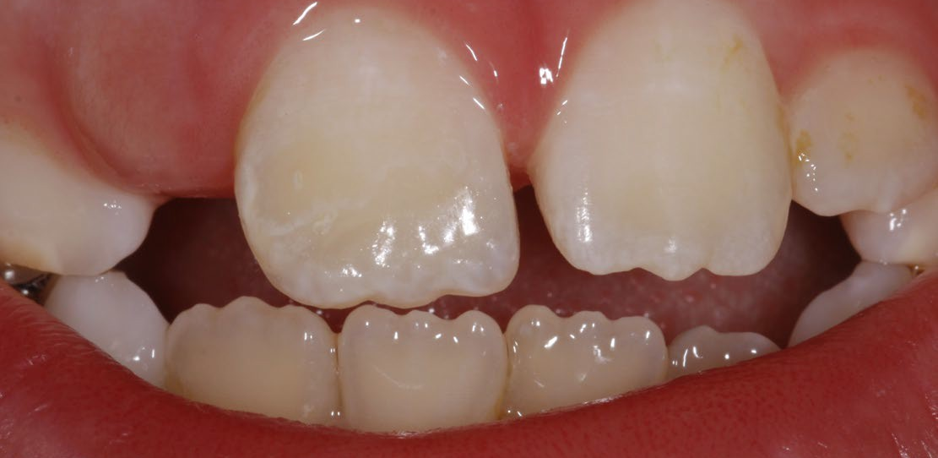
Elevations 2
Mamelons
3 minor tubercles formed along the incisal edges of newly-erupted incisors
This is associated with the developmental lobe of the tooth during tooth formation
Mamelons are not present in most adolescents/adults as the dentition grind down from wear over time

Slide 27
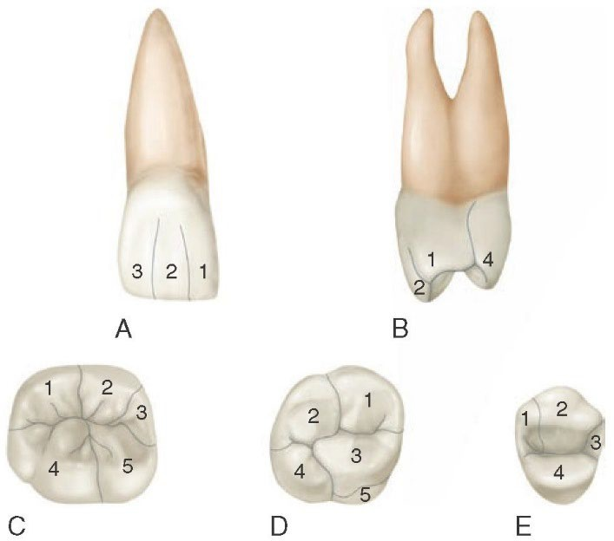
Developmental lobes
Each lobe serves as the local growth centre from which tooth structures form
Remember that the tooth forms from the crown, not the root
As the lobes form the tooth, they fuse to form a unified structure
Such formation may usually result in shallow depressions along the fusion lines -> adds character to the appearance of dentition
Note that this is the reason why mamelons form as 3 entities in incisors from eruption
In rare instances, lobes of adjacent dentition may accidentally fuse, resulting in a mal-fused tooth/teeth
Cusp of Carabelli

Slide 28
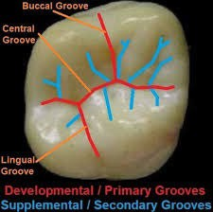
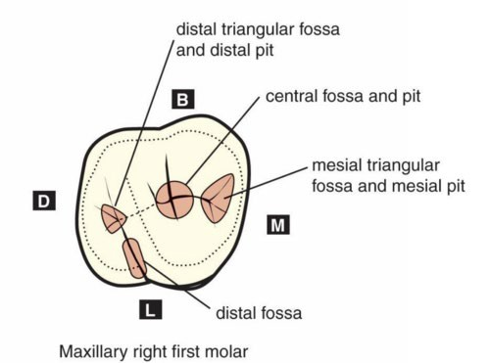
Back to posteriors, grooves & fossae
Remember that the union of two or more cusps form local depressions and sulcus
Groove -> a developmental anatomy that forms a major, but narrow, linear depression
Developmental groove -> the primary entity that denotes the identification of cusps
IE, the base of cusps (junction of lobes) form the developmental groove
Supplemental groove -> secondary entities that define characteristics on the local cusp
Fossa -> local, but overall, concavity/depression regions along regions of the lobe junctions
Forms the indentation regions, along which grooves may concurrently traverse to further depress a narrow region in the fossa

Slide 29
Naming of grooves and fossa
Grooves are named based on their primary location
Central groove -> the main groove that segregates the primary axis of the tooth is defined as the central groove (mesio-distal axis)
If the tooth has more than two cusps, further perpendicular extensions from the central groove may occur, denoted as the buccal groove or lingual/palatal/oblique groove
Supplemental groove -> defined by the local cusp it is associated with, but also explicitly identified as a supplemental form (eg lingual supplemental groove)
Fossae (plural) are named based on either their location or shape
Note that the naming convention is either just by location (central, distal, etc) if the shape is circular or ovoid), or location + shape (mesial triangular fossa) if the shape is unique

Slide 30
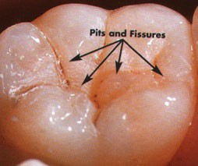
Pits and fissures
The formation of pits and fissures are from anatomical anomaly, despite it being common in occurrence
They are denoted by the formation of some cleft (incomplete fusion) of the enamel
Pits
Local, pinpoint entities that form a visible “hole” generally within a fossa
Pits occur at communicating locations between two or more grooves
Fissures
Narrow, linear cleft in the depth of a groove
IE, incomplete fusion of lobe junctions

Slide 31
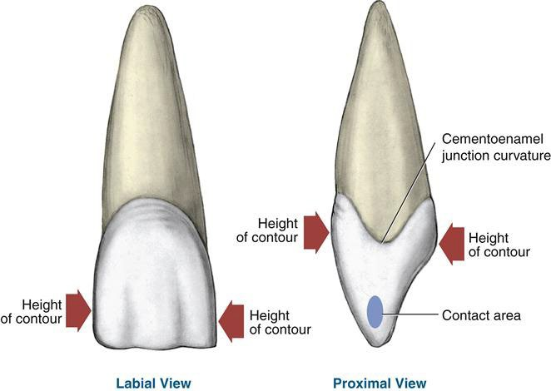
Height of contour
The height of contour is important from both the anatomical and positional point of views
Contour -> shape and extent of the greatest volume/bulge
On buccal and lingual/palatal surfaces -> determines direction of food particles being deflected during mastication
On lateral surfaces -> defines the point of contact with adjacent dentition

Slide 32
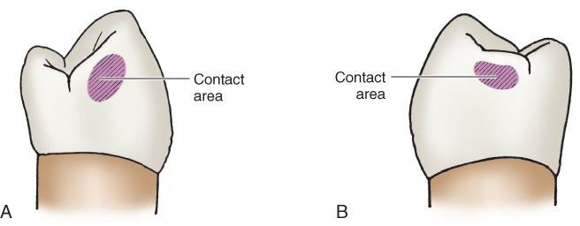
Contact point
The contact point is the widest region of contour that is flattened such that it forms as surface area of contact between adjacent dentition
Protects the underlying interproximal gingival (gum) tissue by minimising/preventing food impaction
Provides support via indirect anchorage of dentition
IE, contact point, despite being called a point, is a specific area on the mesial/distal surfaces that contact the adjacent tooth, but is also not the entire mesial/distal surface that contacts

Slide 33
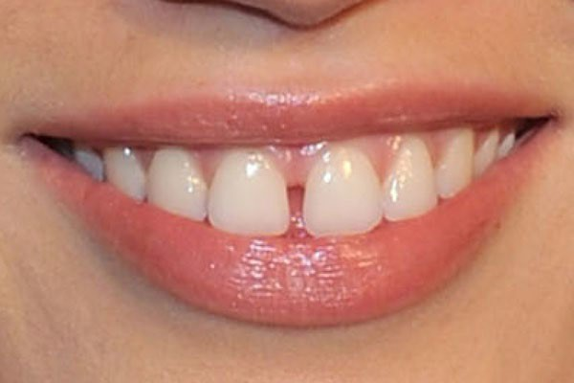
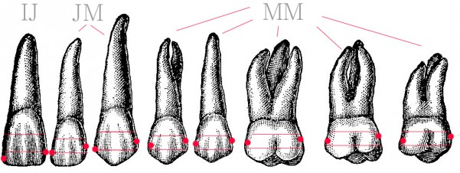
Interproximal spacing
When adjacent dentition are not in contact, this results in a space/gap interproximally
This may occur strategically in the paediatric patient -> allows for space for adult dentition to erupt into
May occur from malocclusion (improper tooth positioning)
Specifically, when the interproximal space is between the maxillary central incisors -> known as diastema
Results in aesthetic “imperfection” which may impact the patient, especially aesthetically/socially

Slide 34
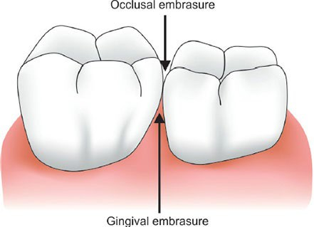
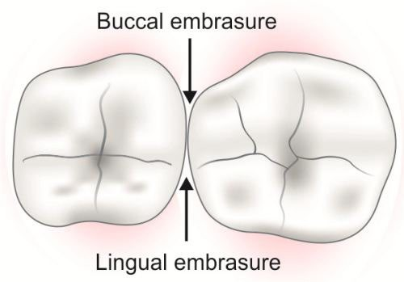
Embrasure space
Given the notion of prominences and ridges, we can appreciate that the contact between two dentition results in specific curvatures and “negative space”
Results in four specific triangularly shaped embrasure spaces
The shape is triangular as it is narrowest at the contact point, and widest away
Specifically in the gingival embrasure, the height (location) of the contact point along the tooth is critical such that:
There is enough embrasure space for interproximal gingiva to fill in the space
No food impaction as the gingiva naturally blocks invasion of debris
The contact point is not too high that there is empty space above the interproximal gingiva

Slide 35
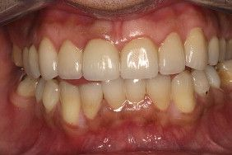
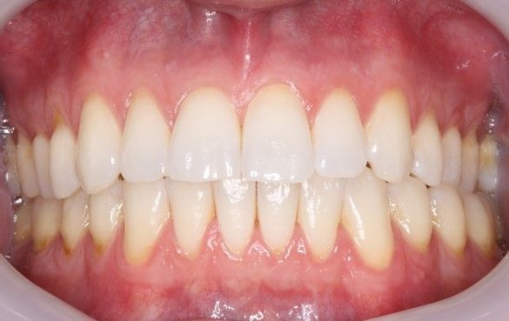

Slide 36
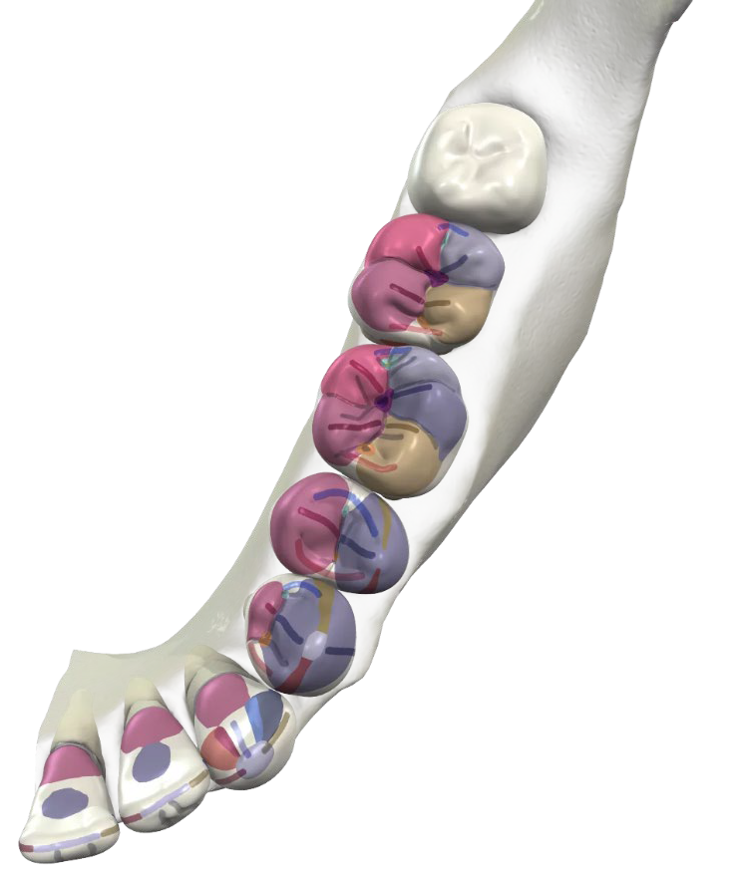
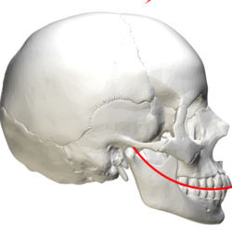
The overall outline form
Note that, based on the information from previous slides, we can identify the following patterns:
Crown outline -> the overall outline shape of the crown, from occlusal view
Occlusal table -> the overall surface of the occlusion, bounded by the marginal ridges and cuspal ridges
In the ideal occlusion, a patient’s occlusal tables will generally follow a unique curve pattern (Curve of Spee)
Occlusal sulcus -> all dentition demonstrate an overall, general sulcus being the pit of the anteriors and central groove of posteriors
In the ideal occlusion, a patient’s occlusal sulcus will generally follow a unique arch pattern (maxillary/mandibular archform)

Slide 37
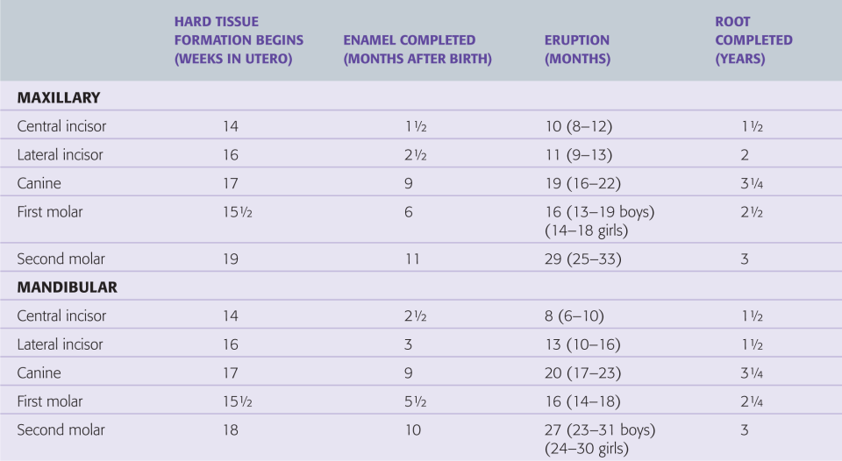
Primary dentition eruption timing
Chart based on Logan WH, Kronfield R. Development of the human jaws and surrounding structures from birth to age fifteen. JADA 20:379–424, 1933/1935. Modified by McCall and Schour: Schour I, McCall JO. Chronology of the human dentition. I4n3: Orban B, ed. Oral histology and embryology. St. Louis, MO: C.V. Mosby, 1944:240.

Slide 38
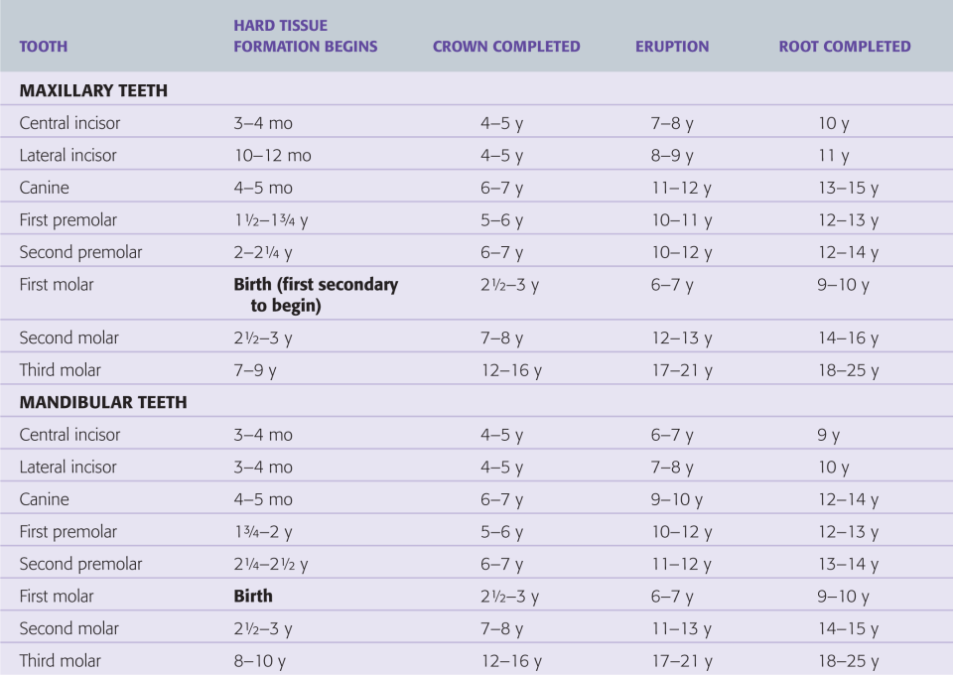
Permanent dentition eruption timing

